Slide 1
September 2023

Slide 4
Notes:
Key points of slide:
Demonstrate TAL’s longevity in the industry and commitment to the insurance market within Australia
Highlight TAL’s scale by protecting 4.9mil Australians and their families
TAL supports various community groups and is an employer of choice
Figures are for period Jan-Dec 2021

Slide 5
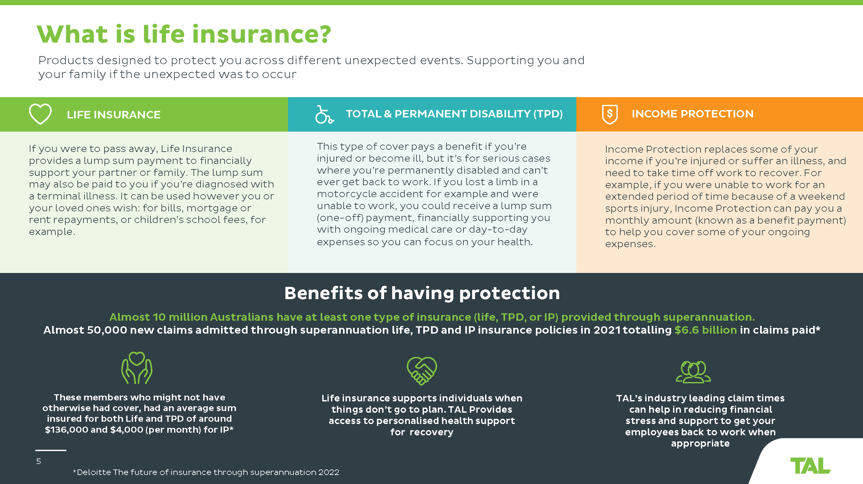
Notes:
Key points of slide:
Explain the different types of insurance that may be available via TAL through their Super Fund and provide employers confidence in having general discussions relating to employee benefits
Demonstrate the benefits of having insurance in place and the protection it can provide employees

Slide 6
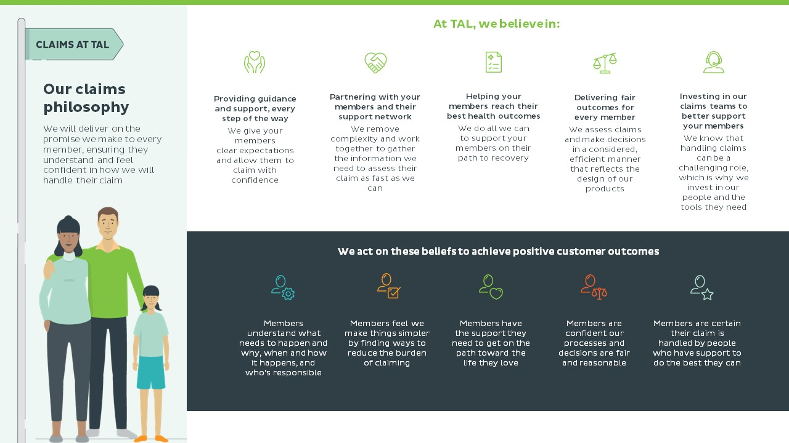
Notes:
Key points of slide:
Introduce TAL’s claims philosophy and how TAL will support delivering fair outcomes for every claim.
Provide confidence that as an insurer we strive to provide positive customer outcomes, not only paying a claim but supporting people to achieve along their journey in what can often be challenging circumstances.

Slide 7
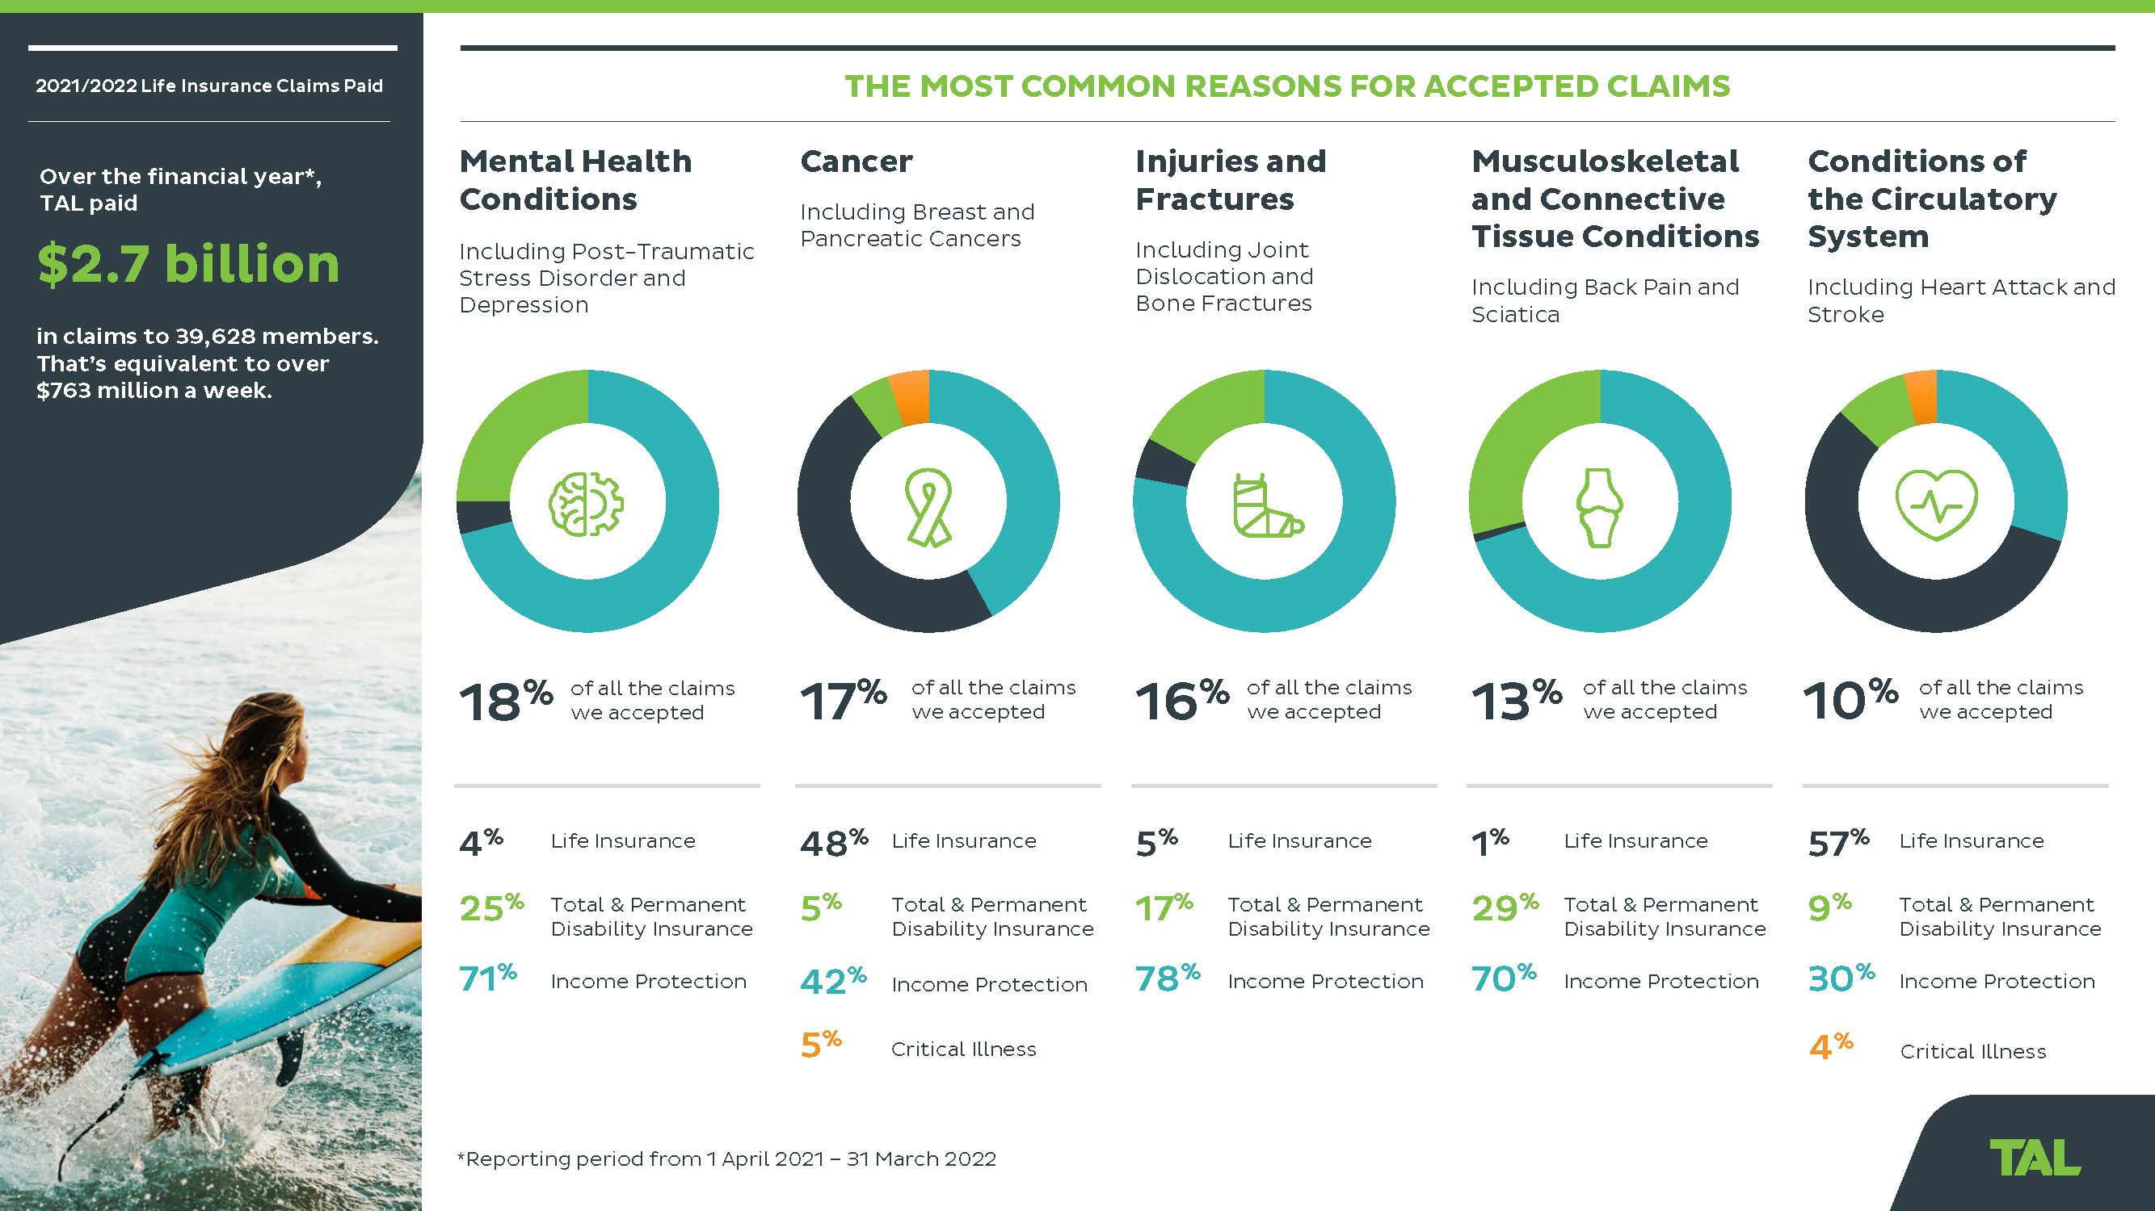
Notes:
Key points of slide:
Demonstrating the large number of people supported and amount of benefits paid last financial year.
Further broken down by product and claim condition.

Slide 8
Introducing TAL Health for Life
Helping your employees live a better life through good health.
TAL Health for Life is here to protect and support your members’ wellbeing at every stage of their health journey. This includes enabling them to live a healthy life before making a claim and supporting them at claim time and as they manage their health condition.
Notes:
As a leading life insurer, TAL partners with us to provide your employees with an evidence-based and holistic health and wellbeing proposition.
It offers expert and targeted programs and services to help them balance their physical, mental and financial wellbeing, while also providing you with the tools to help members get more from life.

Slide 9
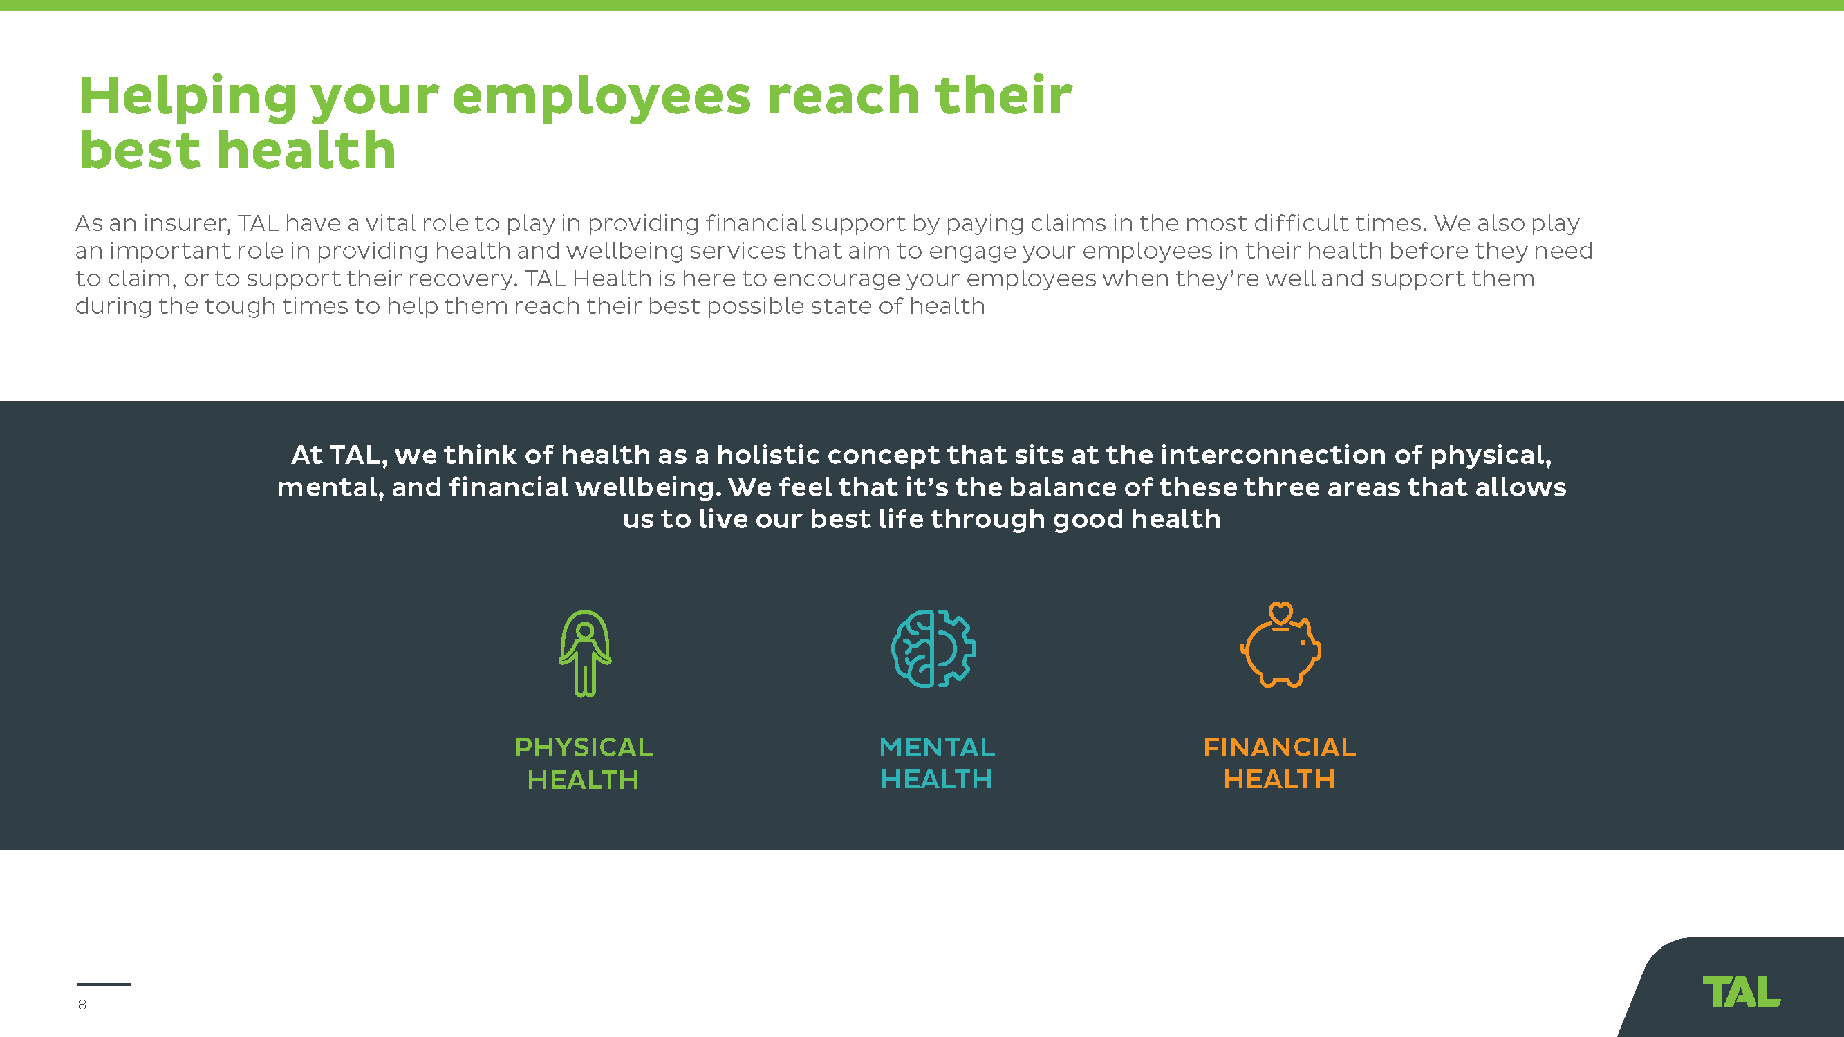
Notes:
Key points of slide:
Introduce TAL’s holistic view of health and outline how TAL play’s an important role in supporting employees at all stages of health not just the financial benefit at claim time

Slide 10
BEFORE EMPLOYEES CLAIM
1. HEALTHY LIVING
WHEN EMPLOYEES CLAIM
2. CLAIMS SUPPORT
DURING EMPLOYEES’ CLAIM
3. EMPOWERING RECOVERY
Supporting and engaging your employees to help them tangibly improve their health outcomes.
Engagement tools to support physical, mental and financial health engagement, and encouraging preventative checks.
Content to help your employees be informed, check themselves and take action.
Employer health activations including skin checks and heart health checks.
Supporting your employees’ health and wellbeing in the event they need to make a claim.
Condition-focused services to manage claim conditions and support carers.
In-house health experts support evidence-based reviews and faster claims decisions.
Access to our online health directory of community-based health services.
Supporting your employees to achieve their best possible health and work outcomes.
Recovery and support specialists help to develop appropriate recovery strategies.
Career and return-to-work coaching to explore future career paths.
Member stories explaining how others coped with their health challenges.
OUR HEALTH FOR LIFE PRINCIPLES
Holistic
Relevant
Impactful

Slide 11
Engaging and supporting your employees on their health
Supporting engagement for healthy living
Support for when things go wrong
Support for managing illness and injuries
Support to empower recovery and return to work
Before members claim
When members claim
During members claim
Engagement tools
Support services
1. HEALTHY LIVING
2. CLAIMS SUPPORT
3. EMPOWERING RECOVERY
Be informed
HEALTH SCREENING TOOLS & CONTENT
Health screening tools and holistic content to encourage health engagement
TARGETED RECOMMENDATIONS
Targeted recommendations and education based on health risk factors
CANCER SUPPORT
HEALTH DIRECTORY
Directory of free and low-cost, community resources through TAL Health Connector
CAREER COACHING
EXERCISE COACHING
Check yourself
TRAUMA SUPPORT
BUSINESS COACHING
WORK CONDITIONING
ACCESS TO RELEVANT SERVICES
Needs-based access to services including psychologist appointments for mental health support
GRIEF SUPPORT
Phone-based support for members and their families
Take action
PAIN SUPPORT
RETURN-TO-WORK COACHING
FATIGUE SUPPORT
CARER SUPPORT
Access to education and support for a member’s carer
MENTAL HEALTH COACHING
MENTAL HEALTH SUPPORT
Early intervention via telehealth, including Mental health Assist
PHYSICAL HEALTH COACHING
Notes:
Screening tools and content
Targeted recommendations
Supporting access to services

Slide 12
Notes:
Key points of slide:
Further to TAL’s holistic view on health we see the value of preventative engagement
TAL want to support employees in understanding potential health blind spots and potential actions that can be taken to ensure they are keeping healthy today, for a healthier tomorrow.
Preventative health to TAL includes three pillars
Be informed – understanding their risks and way to live a healthier life
Check yourself – completing regular preventative health screening exercises to allow earlier detection of potential conditions
Take action – management of health risks to prevent condition progressing to a serious condition.

Slide 13
Notes:
Key points of slide:
When on an income protection claim TAL has many additional health support services that ensure employees are supported with a personalised approach for their recovery and return to work journey.

Slide 14
Holistic coaching to help your employees reach their best health and work outcomes
Career Coaching
Mental Health Coaching
DELIVERING LEADING HEALTH OUTCOMES IN 2022
81%
Proportion of employees who increased their capacity for work or were working following TAL Health for Life support services.
1,961
Number of TAL Health for Life support services engaged by income protection claimants.
35+
Specialist health providers supporting members to participate in evidence-based programs.
Business Coaching
Physical Health Coaching
Empowering recovery
Return to Work Coaching
Exercise Coaching
Work Conditioning
Emotional support stories
14
Notes:
Suggested talking points: Because we <insert fund name> partner with TAL, our members get access to these health engagement and support tools
By Partnering with TAL, your members get access to these health engagement and support tools.
Health Engagement = Preventative tools
Health Support = Remedial tools

